Slide 1
Capstone Project - Football Statistics : UNCOVERING THE NUMBERS THAT RULE THe GAME
By : Gaurav Sharma

Slide 2
Introduction
Football or Soccer is a worldwide played sport that has a huge fan following in every habitable continent.
So, it becomes a vital part to perform analysis on different parameters that influence this game. By performing analysis on different aspects of football, we will be able to identify patterns, insights, potential gaps, and many more.
Football data analysis consists of the process of collecting data, cleaning and then performing analysis on the data to extract meaningful insights.
The insights that we will gather from here will play a pivotal role in determining important decisions to be made in football.

Slide 3
Project Breakup
Data Preprocessing => This includes preparing data for analysis by merging various data files into a single file, and then performing data cleaning, data analysis on the merged data.
Interpretations => Along with the analysis, we will be writing interpretations, as these interpretations will play a big role in making future decisions.
Presentation => Finally, we will be moving towards the step of creating a presentation, so that we can show our findings clearly and help the stakeholders and audience to make informed data driven decisions.

Slide 4
Focus Areas
Performance Analysis
Player profile and Market value
Team comparison
Attendance and Stadium analysis
Referee Analysis
Substitution patterns
Event Analysis
Competition Analysis
Player Attributes and Demographics
Contract Management

Slide 5
Tools and Techniques
Python
SQL
Tableau
Machine Learning using Python

Slide 6
Phase 1: Data Cleaning and Pre-processing
Data loading => Loaded the 5 datasets to be merged.
Data Merging => Merged 5 datasets into 1 dataset.
Handling missing values => Handled categorical and numerical missing values separately. For categorical, used mode of the column to fill the null values and for numerical columns, filled the null values using either median or mean.
Data Cleaning, Preprocessing => Following steps are taken for achieving data cleaning and data preprocessing -
Dropping columns with high null value percentage => We will drop the columns from the data frame which are having high null value percentage.
Redundant columns removal => Removed columns which were duplicated after the merging process.
Removing Outliers => Removing outliers using the winsorization process.
Saving the final data set.
Note : Connected the python with SQL platform to save the final data set

Slide 7
Focus Area 1 => Performance analysis
Probability => Probability of getting 'type' as 'Goals', given the player is from 'Germany’
A : The 'type' is goal
B : The player is from Germany
p(A/B) = p(A and B) / p(B)
Probability of getting 'type’ as 'Goals', given the player is from 'Germany’ is 0.07.
Probability of 'sub_position' being 'Right-Back' given that the player is from 'right' foot playing category
A : The sub position is right-back
B : Player is 'right' footed
p(A/B) = p(A and B) / p(B)
p(A and B) => sub position is right-back and player is right footed
p(B) => player is 'right' footed
Probability of 'sub_position' being 'Right-Back' given that the player is from 'right' foot playing category is 0.11.

Slide 8
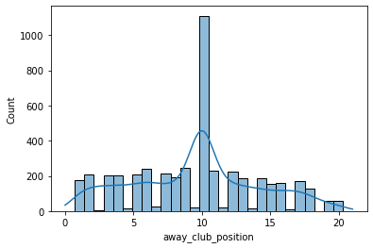
Focus Area 1 => Performance analysis (Continued)
Probability of 'away_club_goals' being greater than 2.0 given that the player is from 'United States’
A : The away_club_goals are greater than 2.0
B : The player is from 'United States’
p(A/B) => p(A and B) / p(B)
p(A and B) => away_club_goals are greater than 2.0 and the player is from 'United States’
p(B) => player is from 'United States’
Probability of 'away_club_goals' being greater than 2.0 given that the player is from 'United States’ is 0.119
Data Sampling, Normal Distribution and CLT
Checking if ‘away_club_position’ follows CLT theorem by using data sampling
Population Distribution =>

Slide 9
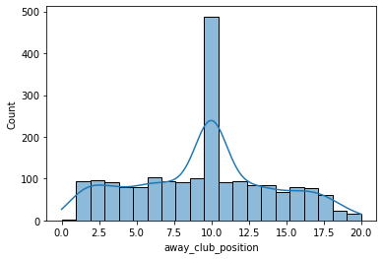
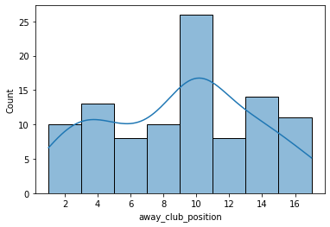
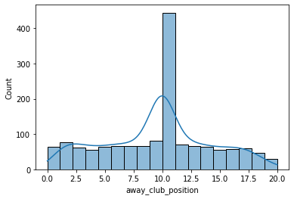
Focus Area 1 => Performance analysis (Continued)
Sample size 100 distribution
Sample size 1500 distribution
Sample size 2000 distribution
Sample size of 2000 fulfils all criteria to represent the entire population and follows CLT, as it’s mean and median(9.58,10.0) is very close to the population mean and median(9.55,10.0), and as the size of sample is greater than 30.

Slide 10
Focus Area 1 => Performance analysis (Continued)
Logistic Regression => Can we predict ‘type’, that is the type of game event from various features?
Independent features => ['height_in_cm','foot','minutes_played','competition_type','round','attendance','yellow_cards','red_cards','type_y’]
Dependent feature => [‘type_y.enc‘]
Confusion matrix => True Positives: [ 10 0 188 673]
False Positives: [ 23 0 157 355]
False Negatives: [ 64 164 198 109]
True Negatives: [1309 1242 863 269]
Accuracy score: 0.6194
F1 score: 0.5646
Recall score: 0.6194
Precision score: 0.5296
Roc score : 0.7030

Slide 11
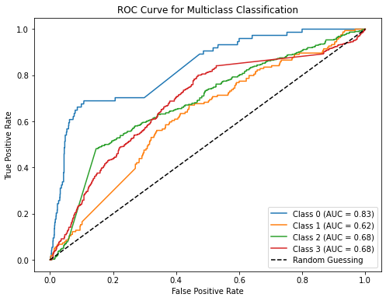
Focus Area 1 => Performance analysis (Continued)
Roc – Auc Curve

Slide 12
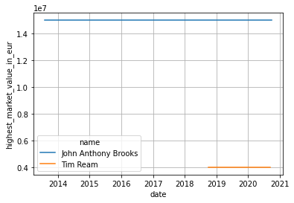
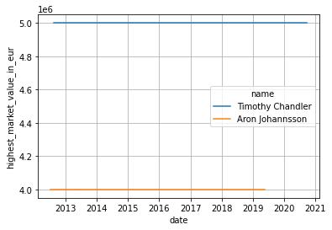
Focus Area 2 => Player profile and market value
Descriptive Analysis
Linear Regression
How does a player's dominant foot affect their market value in euros?
Predicting market value from various features
2 independent features with 1 dependent feature ->
MSE: 0.1429
MAE: 0.2476
RMSE: 0.3781
R-2 score: 0.8563

Slide 13
Focus Area 2 => Player profile and market value (Continued)
Linear Regression
Linear Regression
Model with 3 independent features and 1 dependent variable
MSE: 0.1228
MAE: 0.2318
RMSE: 0.3505
R-2 score: 0.8742
4 independent features with 1 dependent feature ->
MSE: 0.1146
MAE: 0.2240
RMSE: 0.3385
R-2 score: 0.8874
The model with 4 independent features has the best metrics among all the other models that were tested, and to support it more, the accuracy of this model(0.8795) is very near to the highest accuracy(0.8824) seen in all the models.

Slide 14
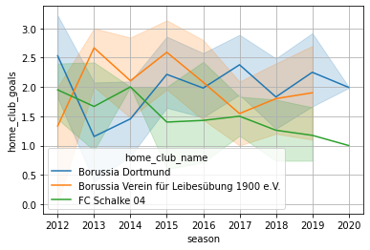
Focus Area 3 => Team comparison analysis
Descriptive Analysis
Hypothesis Testing
Which club shows the biggest seasonal improvement in home club performances?
FC Schalke 04 has been the worst performer across different years, whereas Borussia Dortmund saw their bad season from 2012 to 2013, but after that it showed a gradual increase in the number of goals scored by the club
Can we say that the average attendance, when recorded for 2 competition types -: domestic league vs domestic cup is different?
Null Hypothesis => Attendance has no significant difference when seen for league v/s cup matches
Alternate Hypothesis => Attendance has a significant difference when seen for league v/s cup matches
T-stats: 0.0263
P-value: 0.9789
T-critical: 1.9605
P-value(0.97) > alpha(0.05), so we can say that we will not reject the null hypothesis.
So, we can say that the attendance will not be impacted significantly, when viewed in terms of domestic league matches and domestic cup matches

Slide 15
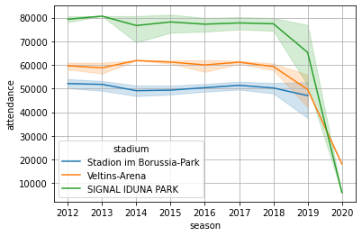
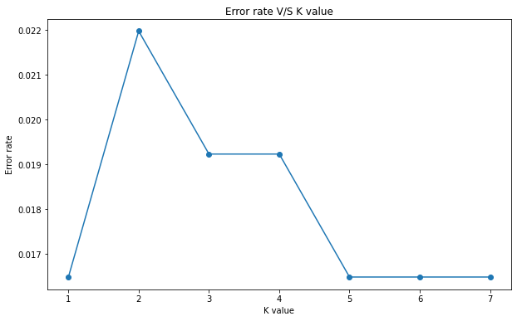
Focus Area 4 => Attendance and stadium analysis
Descriptive Analysis
K Nearest Neighbors Classification
Are certain stadiums consistently associated with higher attendance figures?
We can say that 'Veltins-Arena' and 'SIGNAL IDUNA PARK' had started with a strong attendance numbers back in 2012. They have maintained these strong attendance numbers till 2018. After that, we can see a big fall for these stadiums in terms of attendance. Whereas, we can say that for 'Stadion im Borussia-Park', it has maintained a steady attendance of around 50000 from 2012 to 2019.
We want to judge a player's dominant foot(left or right) based on various input factors
Accuracy: 0.9780
Recall: 0.9780
F1-score: 0.9780
Precision: 0.9780

Slide 16
Focus Area 4 => Attendance and stadium analysis (Continued)
K Nearest Neighbors Classification
Roc score of 0.9956
ROC score of 0.99 indicates that the model is very effectively identifying the data points to be of what category
Looking at all the scores, the model has a very good accuracy of 97.8% which is near to excellent. A good recall score suggests that the model is able to identify correct true positives(indicated by recall) and making accuracte positive predictions(indicated by precision). This shows that the model is not over-fitting nor under-fitting on the classes
Overall, we can say that this model is very effective in telling whether the player is 'right' footed, 'left' footed, or 'both' footed, by considering various features

Slide 17
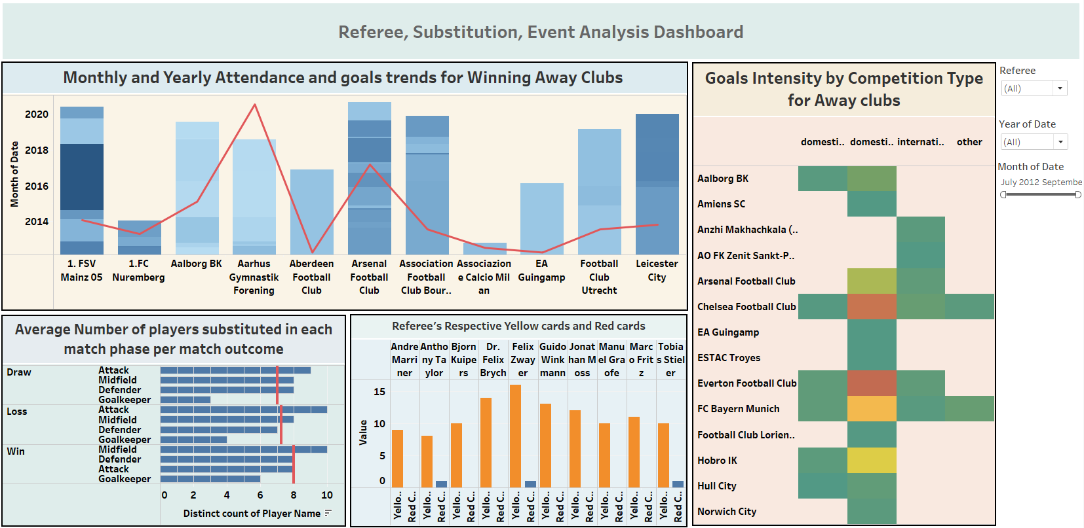
Focus Area 5,6,7 => Referee analysis, SUBSTITUTION PATTERN, EVENT ANALYSIS(DESCRIPTIVE ANALYSIS)
DASHBOARD

Slide 18
Focus Area 5,6,7 => Referee analysis, SUBSTITUTION PATTERN, EVENT ANALYSIS(DESCRIPTIVE ANALYSIS)
DASHBOARD INTERPRETATIONS
Yellow card Analysis => Felix Zwayer has issued the most yellow cards in his career
Red card Analysis => As seen from the graph also, and in general, referee's refrain from giving red cards to the players. From the graph we can see that Anthony Taylor and Felix Zwayer has issued the most red cards.
On an average, when the matches are won, we can see that the average of players substituted are the highest.
In general, players who are in attack position had the most substitutions , followed by Midfield players.
Overall, we can say that matches in which 'Arsenal Football Club' played had the highest attendance, when considered from 2014 to 2020.

Slide 19
Focus Area 7 => EVENT ANALYSIS(Continued)
HYPOTHESIS TESTING
Null Hypothesis (H0) => Teams playing in high-attendance matches did not received significantly different referee decisions as compared to low-attendance matches
Alternate Hypothesis(H1) => Teams playing in high-attendance matches received significantly different referee decisions as compared to low-attendance matches
P-Value => 0.94, T-stats value => 0.07,+T-critical => 2.80
The p-value (0.94) > alpha (0.05), so we will not reject the null hypothesis.
T-stats value (0.07) is not greater than +T-critical(2.80), so we will not reject the null hypothesis
Business Conclusion =>
We can say that the teams when playing in stadiums with high-attendance did not received a different number of yellow and red cards, as compared to the stadiums with low-attendance

Slide 20
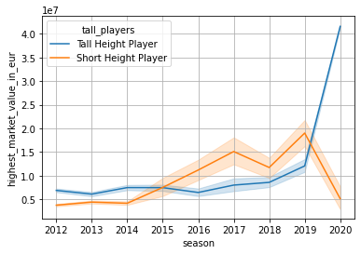
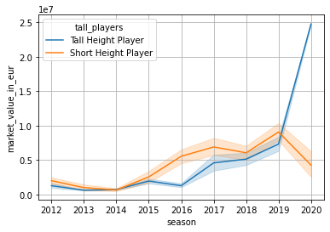
Focus Area 9 => Player attributes and demographics
Descriptive Analysis
Do Tall height players have more market value, when compared historically and currently, than the short heighted players?
Current trend =>
Historical trend =>
As seen from above analysis, we can clearly see that tall heighted players, when seen historically and currently, are showing a sharp increase in the market value after 2019.
If we see on average terms, we can see that tall height players are currently highly valued as compared to short heighted players. But, if we see historically, we can say that short heighted players has had a high share of market share as compared to tall players, as seen from the visualizations also.

Slide 21
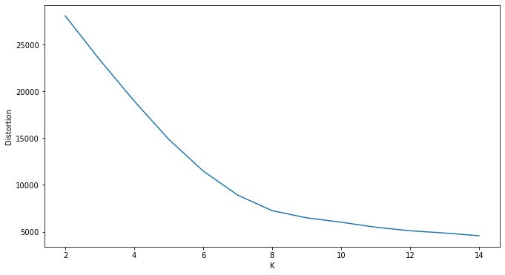
Focus Area 9 => Player attributes and demographics (CONTINUED) K MEANS CLUSTERING
If we apply K-Means Clustering to player attributes other than just height (e.g., market value, goals, assists), reveal distinct player archetypes that could inform scouting strategies for identifying undervalued talent within specific clusters?

Slide 22
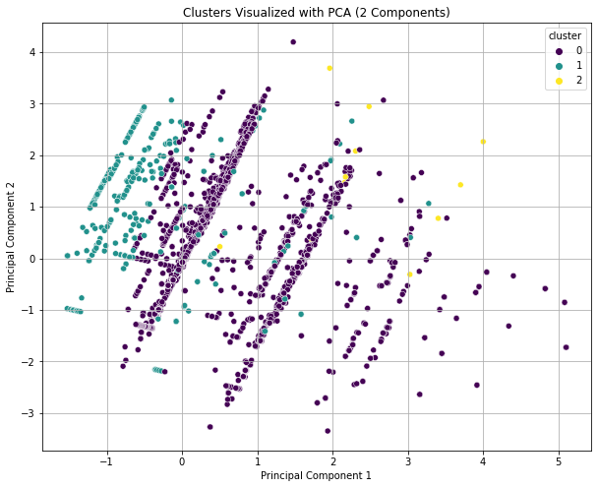
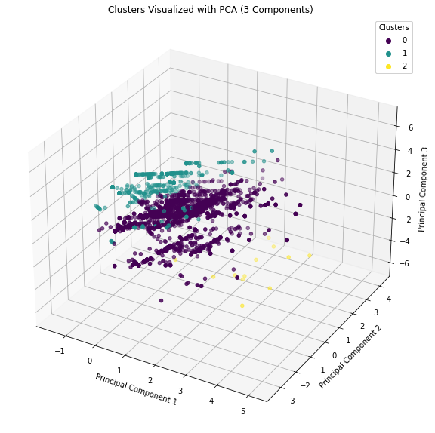
Focus Area 9 => Player attributes and demographics (CONTINUED) K MEANS CLUSTERING

Slide 23
Focus Area 9 => Player attributes and demographics (CONTINUED) K MEANS CLUSTERING
Calinski-HaraBasz score => 944.934
Davies-Bouldin score => 1.039
Silhouette_average score => 0.263
A Davies-Bouldin score of 1.03 suggests that clusters might be experiencing a little leak of points
Calinski-Harabasz score of 944.934 suggests that the clusters are well defined and clusters are having well defined separation between other clusters
A silhouette average score of 0.263 suggests that the model is able to classify points on a moderate basis and that the quality of clusters can also be put under moderate category. There are chances of some overlaps happening

Slide 24
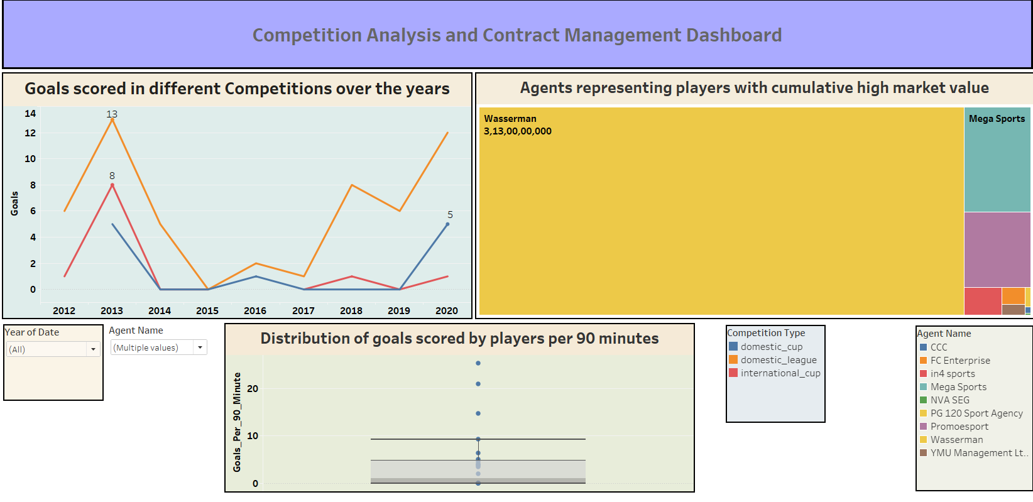
Focus Area 8,10 => Competition analysis, Contract Management
DASHBOARD

Slide 25
Focus Area 8,10 => Competition analysis, Contract Management(CONTINUED)
DASHBOARD INTERPRETATIONS
Domestic league seems to have shown the highest number of goals scored over the years.
Football agent ‘Wassermann’ has shown the highest accumulation of players with the highest market value.

Slide 26
Summary
The tall heighted players are more valuable than short heighted players in terms of market value.
Certain stadiums, such as ‘Stadium im Borussia - Park ’ has shown steady attendance figures throughout the years, whereas stadiums like ‘Veltins - Arena’ has shown sharp decline in attendance numbers after 2019.
Right footed players are more valuable than left footed players in terms of highest market value.
Players in attack category saw the most substitutions happening, following by players playing in midfield.
Matches in which ‘Arsenal Football Club’ played, saw the highest attendance over the years.
The home club which has been performing the worst over the years is ‘FC Schalke’, whereas the best performing home club is ‘Borussia Dortmund’
Football agent ‘Wassermann’ has shown the highest accumulation of market share, seen from the perspective of how many players they have with them.

Slide 27
BUSINESS CONCLUSIONS CONSOLIDATION
As it is seen in football, referee restrains from giving red cards that much. But still, there are certain referees who are giving a lot of yellow cards, and considerable red cards.
Tall heighted players are having more share in market value as compared to short heighted players.
There is no correlation between giving red and yellow cards, whether more or less, when seen in terms of stadiums with higher and lower attendance.
There is no correlation or we can say the attendance will not be impacted significantly when we are seeing domestic league and domestic cup matches.
The players from the ‘United States’ have a low probability of hitting goals greater than 2 on average.
A linear trend can be seen between the matches categorized as ‘won’ and the number of substitutions when seen for different clubs.

Slide 28
THANK YOU

